Slide 1

Introduction to Linux
Presented by:
Je’aime Powell, Texas Advanced Computing Center (jpowell@tacc.utexas.edu)
Ritu Arora, Texas Advanced Computing Center (rauta@tacc.utexas.edu)

Slide 2


XSEDE Code of Conduct
Reference: https://www.xsede.org/codeofconduct
This external code of conduct for XSEDE sponsored events represents XSEDE's commitment to providing an inclusive and harassment-free environment in all interactions regardless of gender, sexual orientation, disability, physical appearance, race, or religion. The code of conduct below extends all XSEDE-sponsored events, services, and interactions.
Anyone who experiences, observes, or has knowledge of threatening behavior are expected to immediately report the incident to a member of the event organizing committee, XSEDE staff, or one of the XSEDE Ombudspersons listed below. XSEDE reserves the right to take appropriate action.
Linda Akli, SURA (akli@sura.org)
Lizanne Destefano, Georgia Tech (lizanne.destefano@ceismc.gatech.edu)

Slide 3
Learning Objectives
After attending this training, the participants would have
Developed familiarity with Linux and working in the command-line mode
Learnt to use the basic Linux commands
Learnt to create and edit files on a Linux OS
Learnt the basics of bash scripting
Learnt to connect to remote XSEDE resources such as Stampede2
Familiarized themselves with the user environment of the Stampede2 supercomputer (which has the Linux OS)
Learnt to submit batch jobs on the Stampede2 supercomputer
Learnt to transfer files to and from a remote Linux system

Slide 4


Please make sure your DUO is working, Globus Connect is installed, and if you are on Windows then PuTTY is installed too
To check DUO:
Portal.xsded.org → “Sign In” → “MY XSEDE” → “Profile” → “Manage DUO”
To check Gobus Connect:
Globus.org → “Log In” → “Endpoints”

Slide 5
Chef’s Menu
Section 1: Linux Primer, Basic Commands, and Connecting to the Stampede2 supercomputer at TACC
Section 2: Linux Commands Continued, SSH, Editing Text From the Command Line, Bash Scripting
Section 3: Using XSEDE Resources, Job Submissions, GSISSH, and Globus

Slide 6
Accessing the content for this class
https://tinyurl.com/yckewsmy

Slide 7
Section 1: History of Linux, Basic Commands, and Connecting to the Stampede2 Supercomputer

Slide 8
Linux is an Operating System (OS)
What is an OS?
Software interface between the user and the computer hardware
Controls the execution of other programs
Responsible for managing multiple computer resources (CPU, memory, disk, display, keyboard, etc.)
Examples of OS: Windows, Unix/Linux, OS X

Slide 9
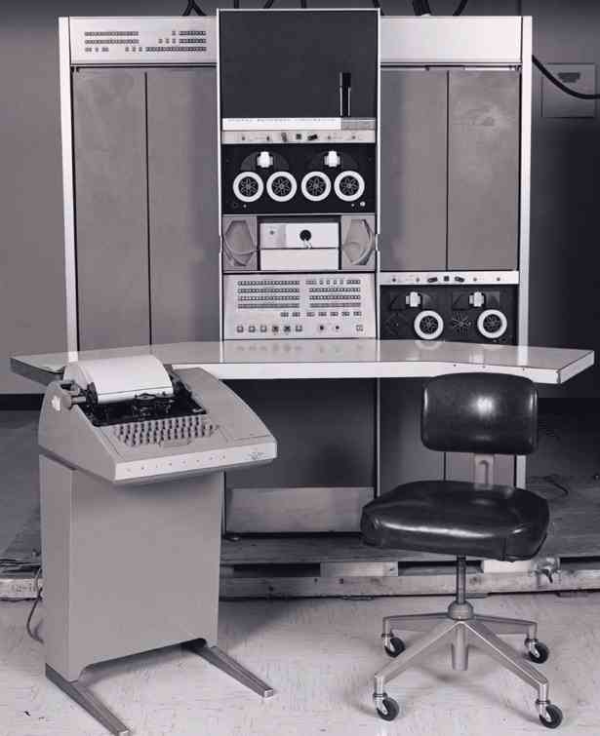

In the beginning there was UNIX and it was EXPENSIVE!!
PDP-7 (1969)
Grace Hopper

Slide 10

Where did Linux come from??
Between 1960-1980 UNIX ruled the world!
In 1984 GNU and in 1991 Linux were both designed as UNIX alternatives
The two were later combined into a single kernel named GNU/Linux.
29 Million Users
or
.7% Market Share
Stallman
Torvald

Slide 11

How much does Linux cost?
Personal Use = Free!
Download from the web.
Borrow from a friend.
Purchase a Disk / Flash drive and install Linux on it.
Enterprise = Up to $10,000 US (Service)
Direct purchase from a Linux distribution company.

Slide 12

Are there choices in Linux?
‹#›

Slide 13

How can I use Linux when Microsoft owns my soul?
Notes:
Changed to used

Slide 14
How can I use Linux when Microsoft owns my soul?
 | WINDOWS | LINUX
Shell | Microsoft Exploder | Gnome, KDE, BASH, Borne, C, Z, T ….
Desktop Publishing | Microshaft Office 2019/365 $249 or $69 - $99/year | OpenOffice (Free)
Web Browser | Edge (AKA the thing I use to download Firefox/Chrome) | Firefox/Chrome/Chromium
Email | Windows Mail App | Evolution Mail/Thunderbird
Software Compiler | Visual Studio (Free as of 2014 prior $1200) | GCC, G++, Make, GFortran, OpenMPI ….
Notes:
--Updated and will note many of the items can be installed into Windows now. The purpose of the slide isnt precision, it is to make generalities that will allow comfort. Note from Ritu: I think our message should not necessarily mean that the students should switch to Linux….moreover, this slide seems to lack precision. Microsoft has stopped supporting internet explorer (Not totally true, they still support Windows 8.1 which uses Internet Explorer), and outlook mail(the built in version of Outlook Lite now named Windows Mail App corrected) has been pushed to office 365 and is browser based to, thereby, making it accessible from any OS that supports a browser (True but trying to make general connection, cloud changes all. For example you could consider Office as being free counting the cloud but that isnt a full featured version of Office any application). Moreover the GCC can work on Windows too using MinGW (agreed and will mention as well as ability to install other Linux shells through the windows store).

Slide 15
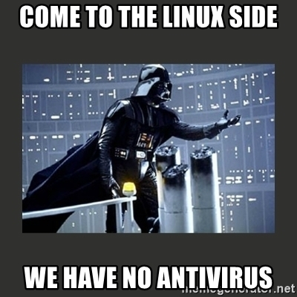
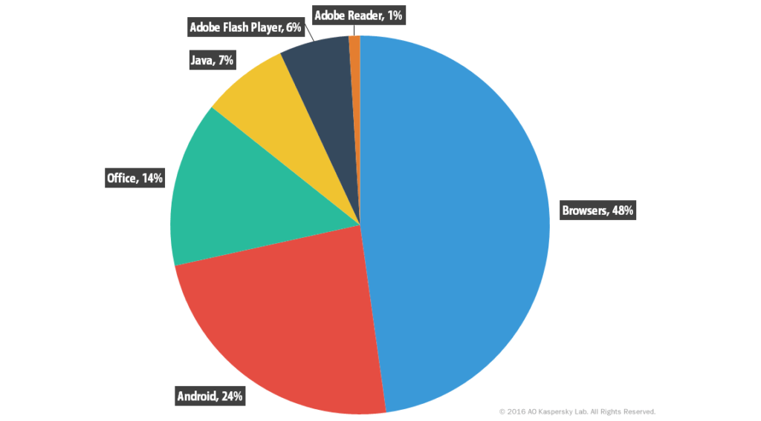
Oh one more thing ...
Vulnerable applications exploited by cybercriminals
Sample of ~16M Ref: https://securelist.com/it-threat-evolution-in-q2-2016-statistics/75640/

Slide 16
Power of “and” and the tyranny of “or”
Giving credit where it is due
Microsoft office brings productivity
Linux brings scalability
Instead of picking between “Linux” or “Windows”, you can very conveniently choose to work with both from your computer should you wish to
You can install a Linux distribution on a pen-drive and boot your computer from it
https://www.pendrivelinux.com
You can install Linux in a VirtualBox and run it on a Windows system
We hear that the latest versions of Windows support WSL - that is, a Windows Subsystem for Linux
In fact, you can work with Linux from your browser window - see slide # 19

Slide 17
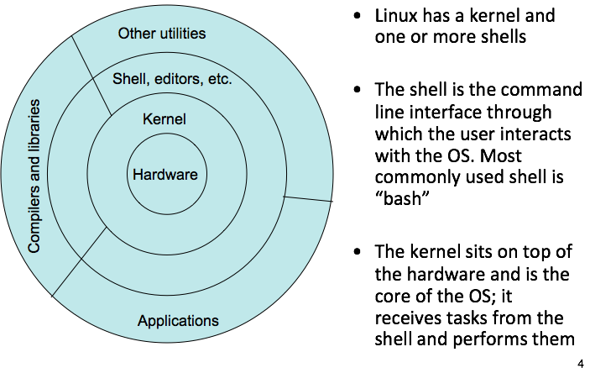
What is a shell?

Slide 18
Files in Linux and the Naming Convention
A file is a basic unit of storage and should have a name associated with it – please note – Linux is case-sensitive
Files are organized into directories and sub-directories
A directory in Linux is a special file
A directory is similar to a “Folder” in Windows OS
In Linux, paths begin at the root directory which is the top-level of the file system and is represented as a forward slash ( / )
Relative path versus absolute path
Forward slash is used to separate directory and file names

Slide 19
Some top-level directories that you will see after installing Linux
/ - the root or base directory
/bin - non-essential binaries (applications)
/sbin - binaries essential to the system
/dev - contains all folders for devices
/etc - contains all configuration files
/home - user specific folder
/opt - holds software add-on packages
/var - holds spooling data
Note for OS/X users: You will see additional directories under the root directory if you are in your Terminal.
General trivia: You can create additional files and directories under the root directory and if you do so, you will see a different tree of sub-directories under the root directory.

Slide 20
Accessing a Linux terminal/shell from your browser
https://tinyurl.com/y8sp8aam

Slide 21
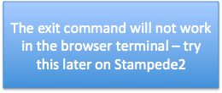
Interacting with the shell
Type a command (ls) at the prompt ($ ) and press ENTER Example: $ ls
Shell starts a new process for executing the requested command, the new process executes the command and the shell displays any output generated by the command
When the process completes, the shell displays the prompt and is ready to take the next command
Specific information is passed to the command via more arguments
The shell is killed by “exit” or CTRL-D
$ exit
logout
Notes:
Difference between CTRL+C, and CTRL+D

Slide 22
Let’s try some Linux commands
To print the name of the current/working directory, use the pwd command
$ pwd
/home1/01698/rauta
To make a new directory, use the mkdir command
$ mkdir csula222
To change your working directory, use the cd command
$ cd csula222

Slide 23
Create, display, and edit a file using “cat”
You can add content to a file as follows
$ cat > test.txt
This is what I am entering from the console
CTRL-D
You display the contents of the file using the cat(short for concatenation) command
$ cat test.txt
This is what I am entering from the console
You can append content to a file as follows
$ cat >> test.txt
Appending more lines
CTRL-D
‹#›

Slide 24
Let us check the currently available files/directories
To list the contents of a directory, use the ls command
$ ls
To list the contents of a directory along with the time-stamp and in reverse chronological order, use the ls command
$ ls -tr
To see all files and directories, including hidden ones use the -a flag with the ls command. Hidden files have a “.” infront of them
$ ls –a
Note: your current working directory can be checked by using the pwd command. Also, you can combine multiple flags in a single command.

Slide 25
Copying files and changing directories
To copy contents of one file to another, use the cp command
$ cp test.txt copytest.txt
$ cp test.txt test3.txt
One more example:
$ mkdir junk
$ cp test.txt ./junk/test2.txt
(The command above copies a file to the sub-directory junk that exists at the current path)
$ cd junk
$ ls
To go a level up from the current working directory
$ cd ..
Relative path example

Slide 26
Exercise-1 (Part A)
Run the following commands to make a directory:
$ mkdir csula29
$ cd csula
Create a file using cat command in csula29 (see slide # 22)
$ cat > test.txt
Run the following commands in the csula29 directory
$ cp test.txt test2.txt
$ mkdir junk
$ mkdir junk2
$ cp test2.txt ./junk/test2.txt
$ cp test2.txt ./junk2/test2.txt
$ ls

Slide 27
Exercise-1 (Part B)
Run the following commands starting from the csula29 directory that you created in Part A of Exercise-1
$ ls
$ cd junk
$ ls
$ cd ..
$ cd junk2
$ ls
$ cd ..
$ ls
$ cp test.txt test3.txt

Slide 28
Deleting files and directories – there is no “undo”
To remove a file, use the rm command
$ rm test2.txt
To remove a directory, use the “ –r ” option with the rm command
$ rm –r junk2
You can also use the rmdir command to remove an empty directory
$ rmdir junk2
Note: rmdir command does not have –r option

Slide 29
Renaming files and directories, getting help, checking differences between files
A file can be renamed by moving it. The same can be achieved by using the mv command
$ mv test3.txt newtest3.txt
Use the man command to get more information about a command – it is like using help in Windows
$ man rmdir
Use the diff command to see the differences in two files
$ diff test.txt newtest3.txt

Slide 30
Checking the previously run commands
Previously executed commands in a shell can be viewed by using the history command. For example:
$ history
1 man ls
2 ls -tr
3 ls -t -r
4 ls -tr
5 history

Slide 31
Viewing large files more or less
If the contents to display are more than one page, you could use the more/less command for paging through text a screenful at a time
$ more test.txt
$ less test.txt
Notes:
less allows both fwd and bwd movement

Slide 32
Creating a tar file
TAR (Tape Archive) command bundles files and sub-directories together and creates an archive (known as tar file or tarball)
To create a tarball of all the files and sub-directories in the directory csula29 that you created in Exercise 1, use c flag:
$ tar -cvf mytar.tar *
To extract the contents of a tar file use x flag:
$ tar -xvf mytar.tar

Slide 33
Creating a compressed tar file
To compress the tar file as it is being created use the z flag with the c flag :
$ tar -cvzf mytar.tar.gz *
To extract the contents of a compressed tar file use x flag:
$ tar -xvf mytar.tar.gz
Note: the c, v, and f flags mean create a new archive, be verbose so that the files being archived are listed, and write the archive to a file.

Slide 34

Connecting to remote computers using a SSH client

Slide 35
What is a Secure Shell (SSH) Client?
The “Secure” part of SSH means the connection utilizes some form of cryptographic (shuffled characters) method to make the plain text traffic, coded to outside viewers.
The “SHell” part of SSH is the interface (e.g., blinking cursor) the user transmits commands or network data through.
The client is an application used to create the SSH connection to a remote computer over a given network.

Slide 36




What happens during a SSH connection
Local
Remote
OpenSSH_7.9p1, LibreSSL 2.7.3
debug1: Reading configuration data /Users/jpowell/.ssh/config
….
$ssh jhpowell@stampede2.tacc.utexas.edu
login1(597)$

Slide 37







Some Sample SSH Clients
Note: We don’t care what SSH client you use as long as you can log into the server.
Windows
-PuTTY
-cmd
MacOS
-Terminal
-iTerm
Linux
-Terminal
Chromium
-Secure Shell Android
-JuiceSSH
iOS
- SSH Term

Slide 38
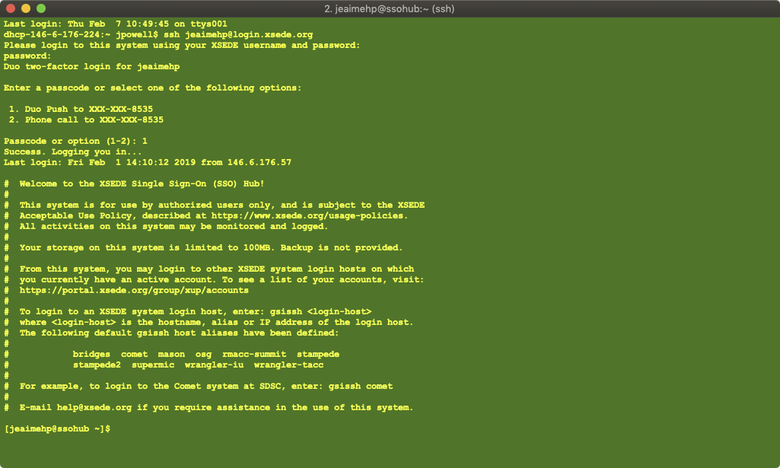

Example from MacOS Terminal App
MacintoshHD → “Applications” → “Utilities” → “Terminal”

Slide 39
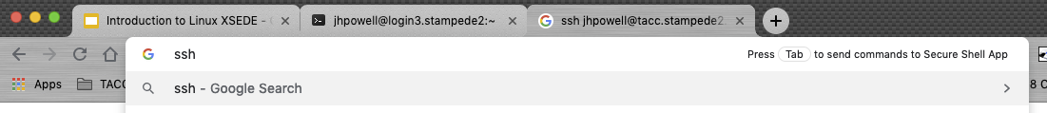
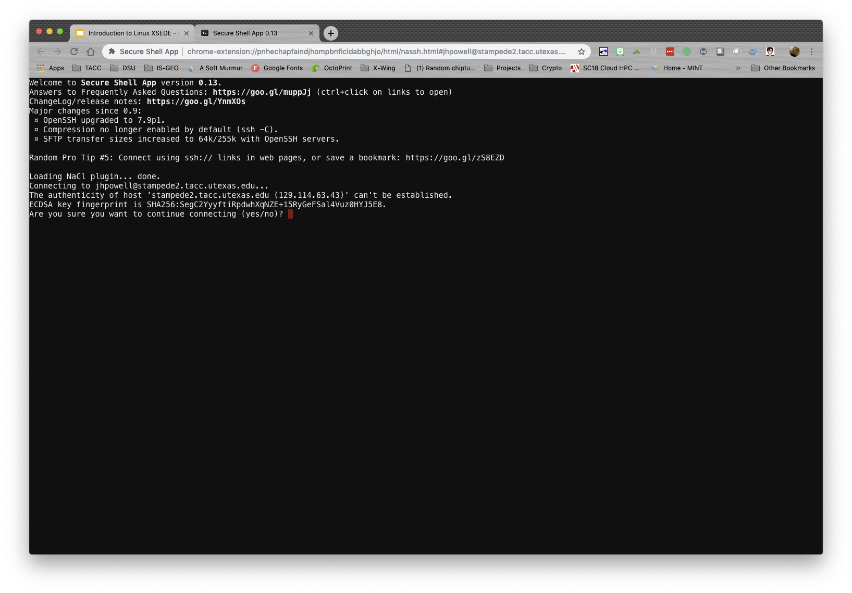

Example from Chrome “Secure Shell App” Extension

Slide 40
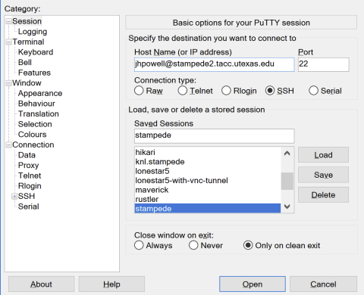

Example from Windows PuTTY

Slide 41
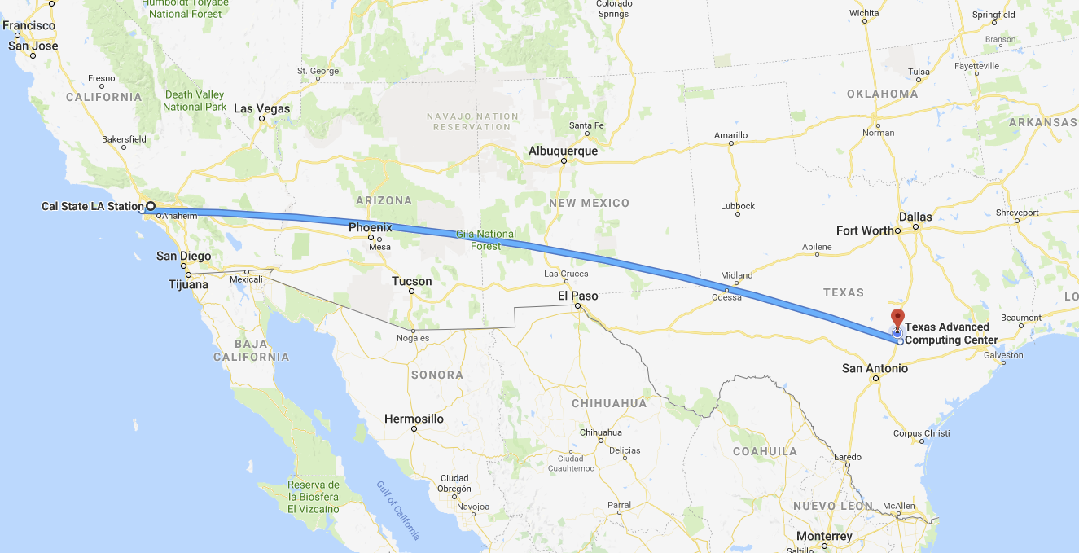

Where you are ...

Slide 42

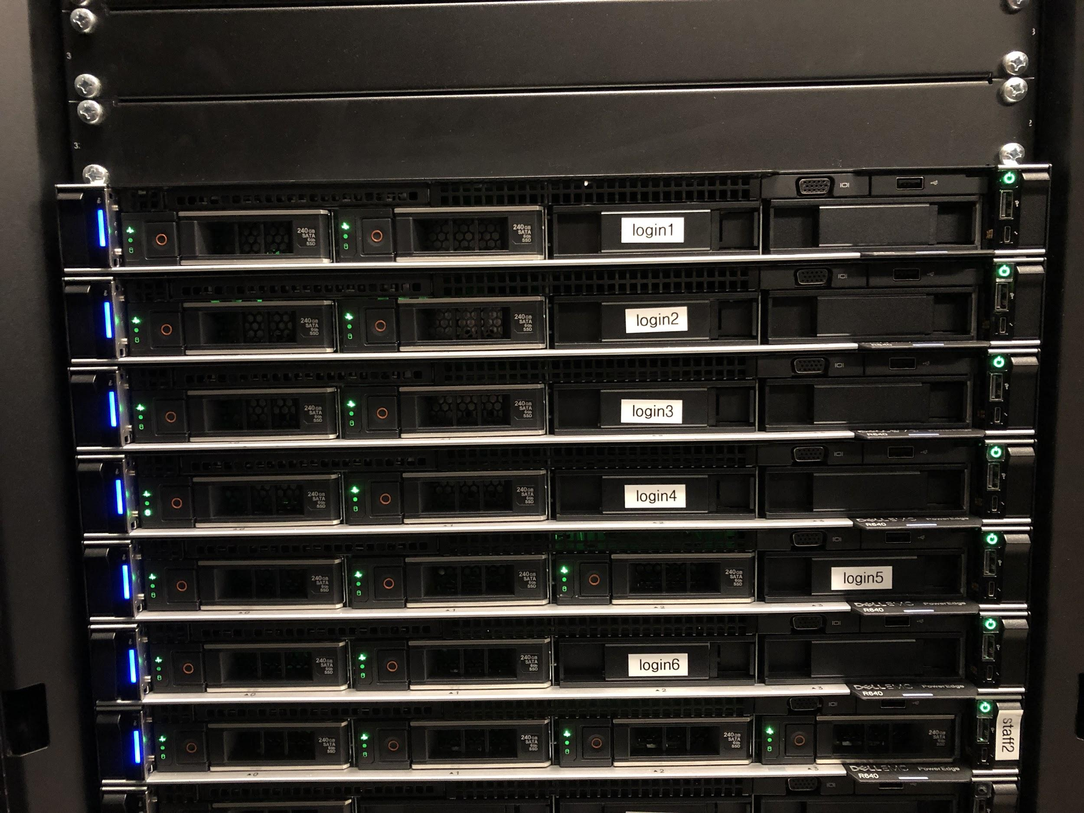

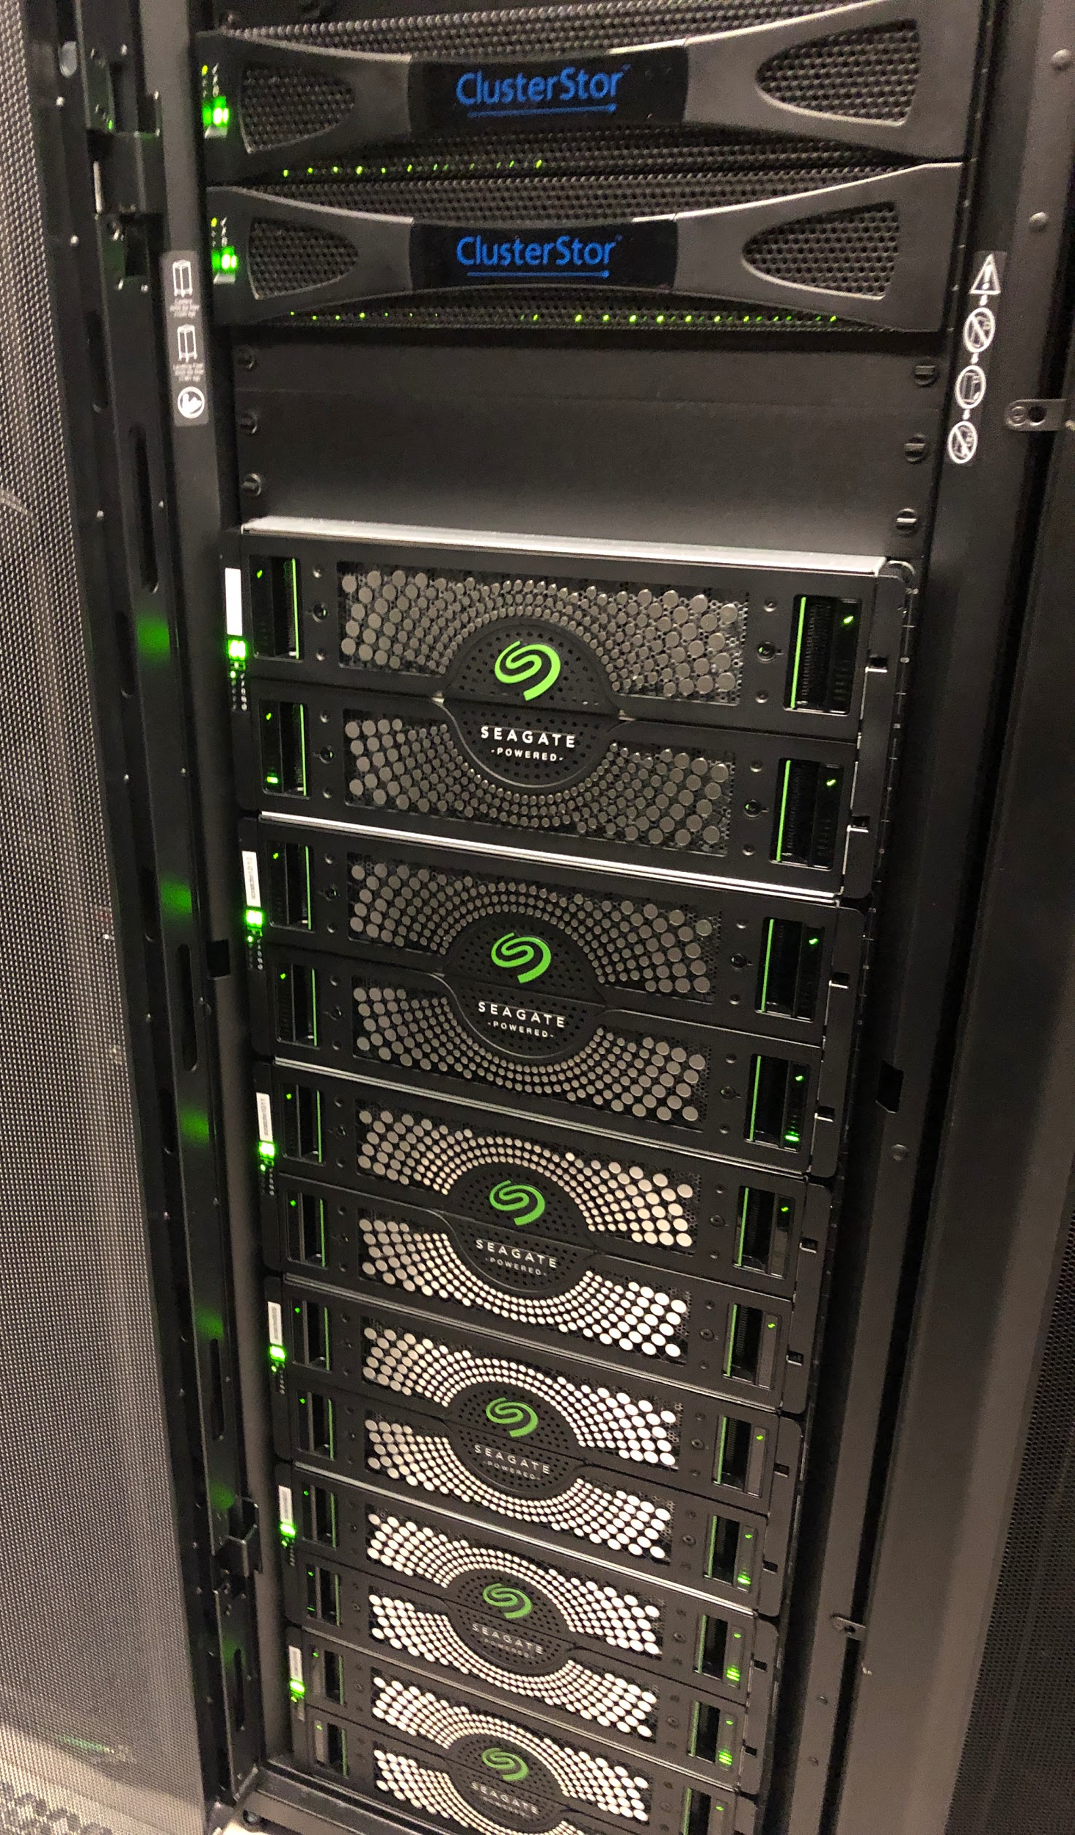
Where you are on Stampede 2 ...
Login Nodes
Home Directory “~” Storage

Slide 43
Let’s connect!
[Note: The username is the training account provided]
SSH to this server:
username@stampede2.tacc.utexas.edu

Slide 44

What we have done so far...
Introduced to Linux history and the Opensource movement/indoctrination
Used some basic Linux Commands
Connected to stampede2.tacc.utexas.edu
NOTE: MAKE SURE YOU ARE LOGGED INTO stampede2.tacc.utexas.edu

Slide 45
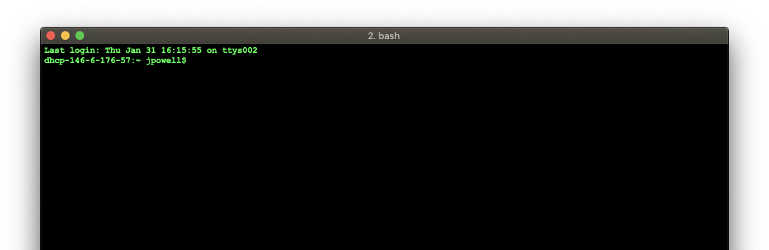

Section 2: Linux Commands Continued, Editing Text From the Command Line, Bash Scripting

Slide 46

Overview
Further practice of Linux commands
Learning to gather Linux system information
Filesystem navigation
File manipulation
Text Editors
NOTE: MAKE SURE YOU ARE LOGGED INTO stampede2.tacc.utexas.edu

Slide 47
Let us run all the commands that you have learnt so far
Repeat Exercise 1
Try the following commands:
$ ls –ltr
$ ls –ltra
You will notice a hidden directory named .ssh
Notes:
Repeat of slide #51 up coming

Slide 48
Some Observations and Generalizations

Slide 49
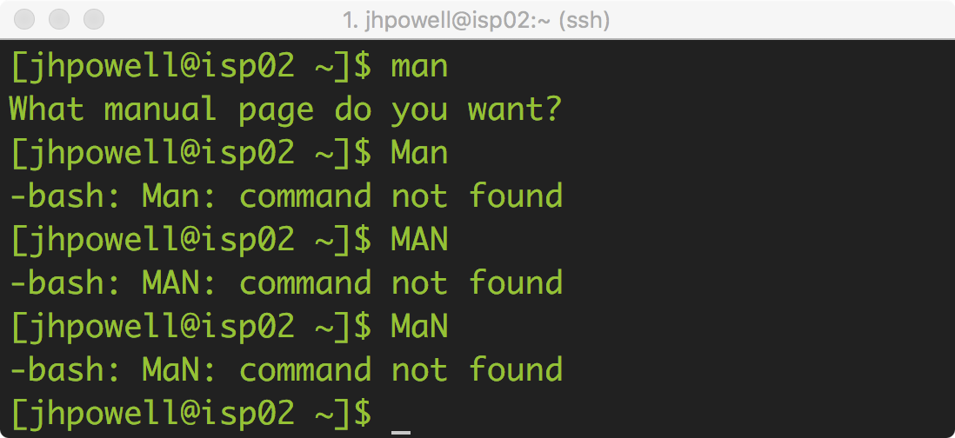
General Linux Command Line Syntax
The command line (and Linux in general) is case sensitive
Example:
The “man” command
man ≠ Man ≠ MAN ≠ MaN
👍
👎

Slide 50
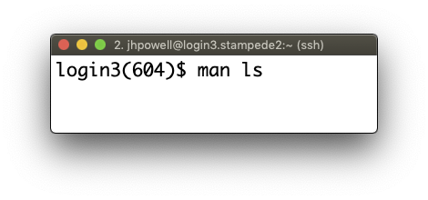
General Linux Command Line Syntax
A Linux command generally has the following syntax…
command -options file1 file2 …
Example of how to use the man command to see what the ls command does:
Syntax:
man ls

Slide 51
Ok I logged in, now where am I?
hostname
hostname -i
pwd
ls
ls -a
ls -l
Shows the name of the server
Show the IP address of the server
Prints the working path or where you are
Lists the files and directories
Lists all files
Lists files with a long listing

Slide 52
What can this machine do?
df -h
who
uname -r
ping
Displays the sizes of the mounted storage
the -h is an option for “human-readable”
Displays currently logged in users
Displays the release of Linux on the machine
Allows you to check if you can communicate with other servers
e.g. ping google.com

Slide 53
How can I move around? Using the commands you have already learnt…
cd <dir>
cd ~
mkdir <dir>
cp </dir/file> </dir/file>
Change to the directory <dir>
Change to your $HOME directory
$HOME is a variable associated with your user account
Make (create) a directory named <dir>
Copy a file from one location to another

Slide 54
Check username and group
Three types of users: owner or user, group, all others
To check the login name use the command whoami or echo $USER
To check the groups you are a member of use the command groups
Members of a Linux group can share files with each other
Each account is assigned a primary group, and an account can be a member of multiple groups
To check your user id, or group id use the command id

Slide 55
File Permissions (1)
Users typically perform the following operations on files:
Read files (using more, cat, etc.)
Write files (using >, editors such as vi, etc.)
Execute commands in a file (executables, etc.)
Each file has three permissions – read, write and execute (rwx)
Person creating the file is the owner or user and can modify permissions as desired
Owner can modify permissions on files to grant or revoke access to other users

Slide 56
File Permissions (2)
To check the file permissions use the -l flag with the ls command
$ ls -l
total 24
drwx------ 2 rauta G-25072 4096 Jan 17 14:07 junk
drwx------ 2 rauta G-25072 4096 Jan 17 14:15 junk2
-rw------- 1 rauta G-25072 65 Jan 17 13:59 test.txt

Slide 57
File Permissions (3)
chmod command is used to change permissions on a file
To add specific permission use chmod +
To add write permission to all users use:
chmod a+w filename
To add read permission to only the users in your group use:
chmod g+r filename
To make a file executable and runnable by any user
chmod a+x myfile
To remove specific permission use chmod –
Add and remove permissions can be combined in a single step
chmod u+x,g+r,o-rwx filename

Slide 58
File Permissions (4)
Instead of using alphabets u, g, o for user, group, and others we can use numbers to specify file permissions
rwx = 111 = 7
rw- = 110 = 6
r-x = 101 = 5
r-- = 100 = 4
-wx = 011 = 3
-w- = 010 = 2
--x = 001 = 1
--- = 000 = 0
chmod go+rx filename = chmod 755 filename
(assuming the user already has the r, w, and x permissions.)

Slide 59
Directory Permissions
To check the contents of a file with ls command, you would need read permission
To add or remove files in a directory, you would need write and execute permission
To change to a directory or to go through its contents, you would need execute permission
To list files in a directory using ls –l command you would need read and execute permissions

Slide 60
Redirecting Output
By default, the output is displayed on the screen
“ > ” symbol can be used to redirect the output to a file or a utility (e.g., ls). Example:
ls -ltr > myContent
The “ | “ symbol is used to connect the output of one process to the input of another process
ls -l | wc -l
wc counts the number of lines

Slide 61
Other Directives
“ < ” symbol is used for input redirection
$ mail –s "CSULA class" rauta@tacc.utexas.edu < test.txt
“ >> ” symbol is used for appending output to a file
$ cat test3.txt >> test.txt
“ ; ” is used to execute multiple commands in one step
$ clear;date

Slide 62
Process and process control
ps – display process information on the system
kill pid – terminates the process id
^c (CTRL+c) terminates the running program
$ ps
PID TTY TIME CMD
20482 pts/32 00:00:00 bash
21035 pts/32 00:00:00 ps

Slide 63
Basic commands Recap
hostname
pwd
ls
-ltrah
cd
~
mkdir
cp
history
cat
rm
mv
exit

Slide 64

Command Line Text Editors

Slide 65
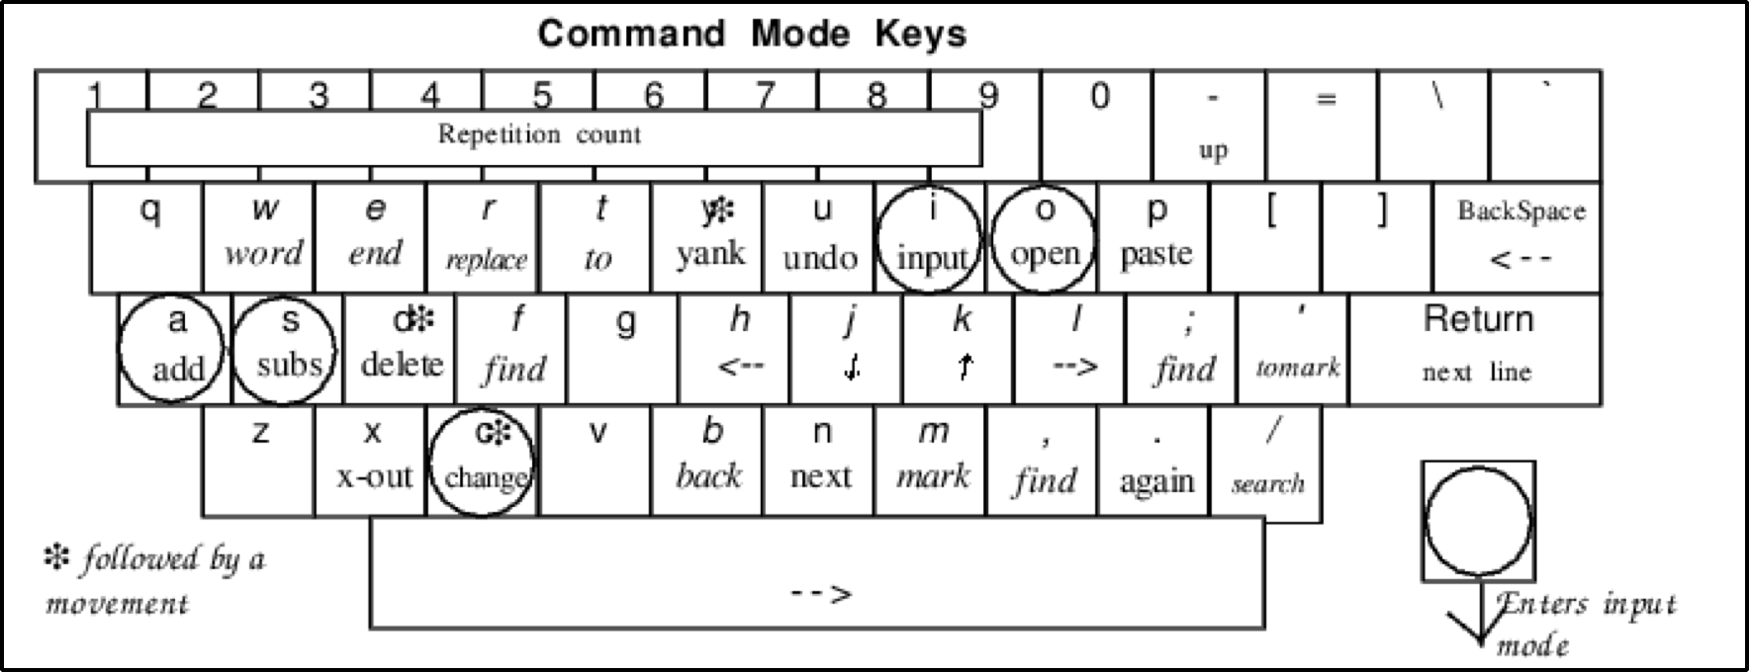
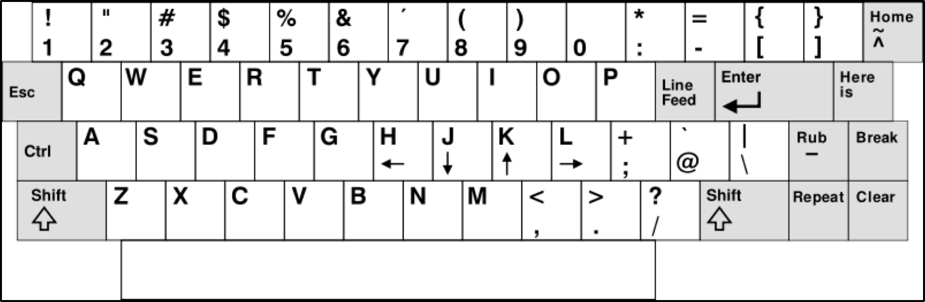
Imagine if you, will a time when ...

Slide 66
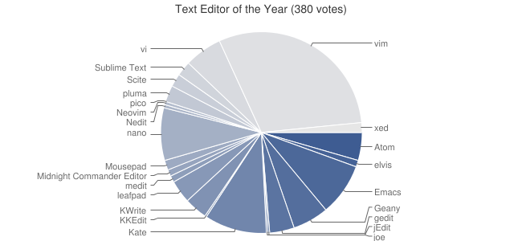
It is up to you to choose your editor
nano
vi
emacs
Ref: https://www.reddit.com/r/vim/comments/5trtbj/and_the_text_editor_of_the_year_is/

Slide 67
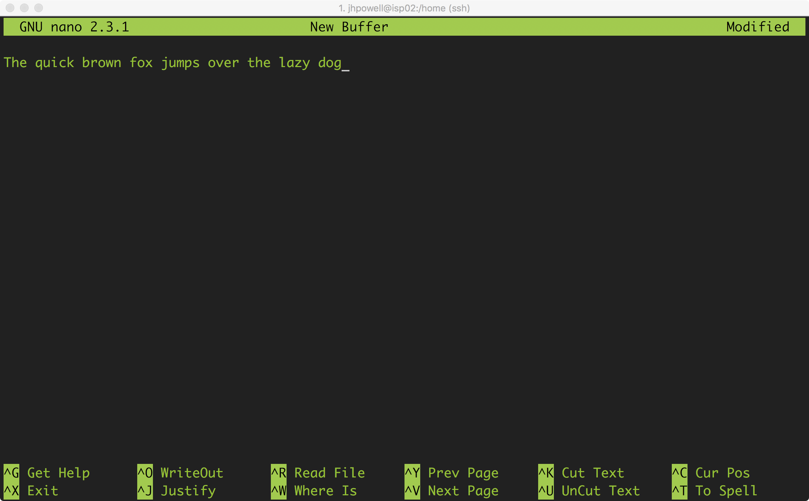
nano
To exit:
press [Ctrl] [X] and then N and [Enter] to not save

Slide 68
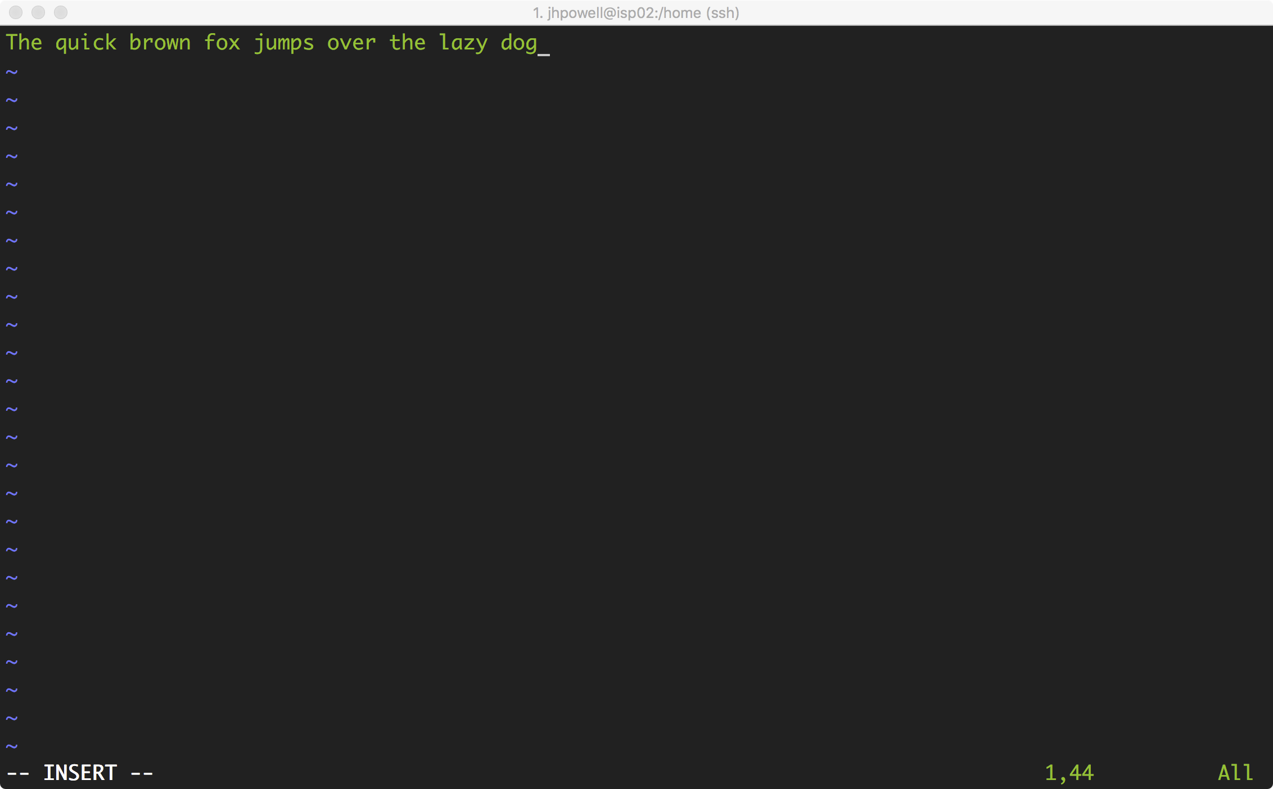
vi/vim
To exit:
press [Esc] and then type :q! and [Enter] to not save

Slide 69
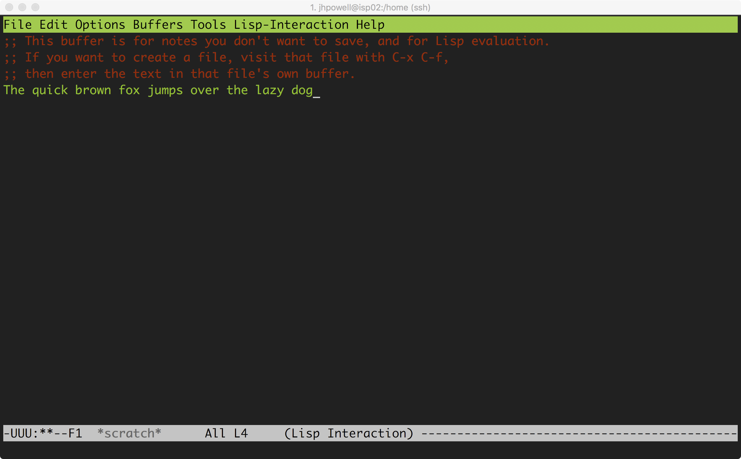
emacs
To exit:
press [Ctrl][x] then [Ctrl][c] to not save

Slide 70
Quick vim exercise
Command | Effect
vim file.txt | open "file.txt" and edit with vim
i | toggle to insert mode
<Esc> | toggle to normal mode
<arrow keys> | navigate the file
:q | quit editing the file
:q! | quit editing the file without saving
:w | save the file, continue editing
:wq | save and quit
Goal: Type:
“The quick brown fox jumps over the lazy dog.” into a text file in your home directory.
Hints:
Do not touch your mouse/trackpad!!!
vi filename.txt to start
Use i to enter insert mode
Use [Esc] to leave insert mode

Slide 71
One more time - editing files using the vi editor
To create a new file use the vi command (see cheat-sheet)
$ vi test2.txt
Press i to start inserting text
Type some text: Hello Class!
To save and quit, press “ Esc ” key, and enter :wq!
(press the enter key after typing :wq!)
To quit without saving, press “ Esc ” key if in insert mode, and enter “ :q! ”
To display the contents of the file, use the cat short for concatenation) command
$ cat test2.txt

Slide 72
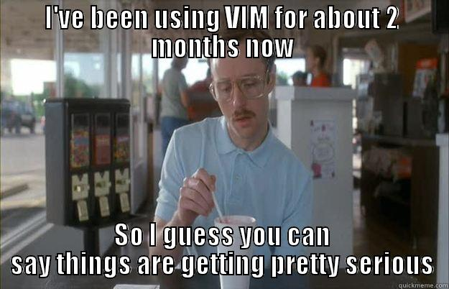


Try the three (or more) editors and choose one!

Slide 73

Scripting Time!

Slide 74
Linux Scripting
Instead of typing commands directly in the shell, you can place the commands in a file, grant execute permissions to the file, and then run the file from the command prompt
Such a file that contains the Linux commands is known as a shell script
Three commonly used types of scripts: Bourne shell, C shell, Korn shell
We will work with Bourne shell script – the simplest one

Slide 75
Creating and running a simple shell script
Create a file named myScript.sh and put the text below in it
You may use vi or nano or any other editor of your choice
#!/bin/sh
echo "hello world"
Change the permissions on the file to 700, or just use, “+x”
chmod 700 myScript.sh
chmod +x myScript.sh
Execute the file by typing ./myScript.sh

Slide 76
Comments in scripts
Except the first line in the script (indicating the shell to be used), any line beginning with a # character in the first column is taken to be a comment and is ignored
#!/bin/sh
# purpose:print current directory path and its contents
pwd
ls

Slide 77
Shell variables (1)
Shell script can contain variables – just like in C/C++/Fortran - and these variables are treated as strings
Variables can be system-defined (e.g., $HOME, and $PATH) or user-defined ($name see below)
The script variables can be assigned values, manipulated, and used
Note that there should be no space before and after the assignment operator
Note how the variable is used in the example below by prefixing “$” sign
#!/bin/sh
#Below is the declaration of a variable
name="Ritu"
echo "The name is $name"

Slide 78
Shell variables (2)
#!/bin/sh
clear
echo "Hello $USER"
echo "Today is "; date
echo "Number of files in directory: " ; ls | wc -l
echo "Calendar is presented below"
cal
clear command will clear the terminal screen
$USER is system-defined variable
date command prints the current date along with the time – notice “;” for separating the echo command and date
cal command prints the calendar

Slide 79
Passing arguments to shell scripts
The special variables $1-$9 correspond to the arguments passed to the script when it is invoked
Although the Bourne shell can have any number of parameters, the positional parameters (or variables) are limited to numbers 1 through 9
$ ./myScript4.sh Ritu Arora
The name entered is Ritu Arora
#!/bin/sh
echo "The name entered is $1 $2"

Slide 80
Conditionals in shell scripts
The if-statement begins with the keyword if, and ends with the keyword fi
The if keyword is followed by a condition, which is enclosed in square brackets, e.g., if [$1 > 5]
The line after the if keyword contains the keyword then
You may include an else part if needed:
#!/bin/sh
if [ -d $1 ]
then
ls $1
else
cat $1
fi
The if condition checks if $1 is a directory or not

Slide 81
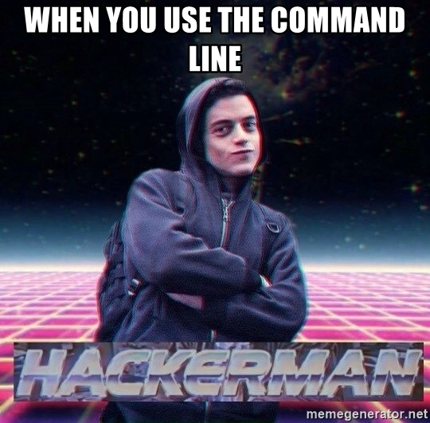
Section 3: Job Submissions, Using XSEDE Resources, GSISSH, and Globus

Slide 82
Loops in shell scripts
#!/bin/sh
for i in `ls`; do
echo $i
done
Loops are used to repeat steps. Two kinds: for and while

Slide 83
Exercise-2
md5 is the command that can be used to find the checksums of a file, the usage syntax is as follows:
md5sum <file-name>
Write a script that finds the checksum of the file whose name is provided as input
Notes:
#!/bin/sh
md5 $1

Slide 84
Solution to exercise-2
#!/bin/sh
md5 $1

Slide 85
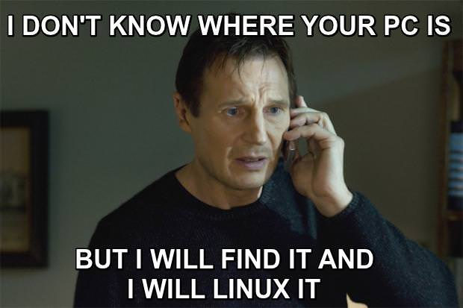
Objectives
Student will…
Connect to the XSEDE SSO Login Node
Use gsissh to access Stampede2
Submit a job to Stampede2
Use Globus to transfer files
NOTE: MAKE SURE YOU ARE SSH’D INTO stampede2.tacc.utexas.edu

Slide 86
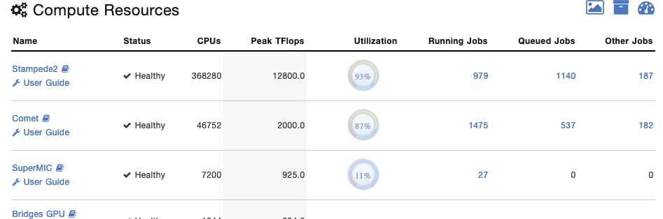

What is XSEDE?
“XSEDE is an NSF-funded virtual organization that integrates and coordinates the sharing of advanced digital services - including supercomputers and high-end visualization and data analysis resources - with researchers nationally to support science.”
In short, they connect scientists, researchers, and students (like you!) to large scale computing resources.

Slide 87
XSEDE Prerequisites
An active xsede.org account
An active allocation on a XSEDE resource
https://portal.xsede.org/allocations/startup

Slide 88
Getting on a XSEDE resource the SSO and gsissh
First we are going to SSH first to: login.xsede.org
Second we are going to “gsissh” to Stampede 2
But why two SSH steps??
This allows you user credentials (username and pasword) to travel with you based on your “Allocations”!

Slide 89
Batch mode versus interactive mode
A sequence of commands to be executed on the compute nodes is listed in a file (often called a batch file, command file, or shell script) and submitted for execution as a single unit – this is batch mode of job submission
Multiple resource managers and job schedulers used across different XSEDE resources
Examples include: TORQUE resource manager and PBS job scheduler, SLURM as resource manager and job scheduler
Interactive mode is opposite of batch mode - commands to be run are typed individually on the command-prompt
See user-guide for more information
Do not run your programs on login nodes – only do installation and code compiling

Slide 90
Job scheduling
All TACC/XSEDE compute resources use a job scheduler for running jobs
All jobs are placed in a queue after they are submitted

Slide 91
Job schedulers
Attempt to balance queue wait times of competing jobs with efficient system utilization
Job prioritization influenced by number of cores and wall clock time requested
FIFO queues with fair use mechanisms to keep a single user from dominating the queue
Backfilling unused nodes with smaller jobs
Will not start jobs if they will not finish before scheduled system maintenance

Slide 92
Script for submitting a batch job
Refer the user-guide of the TACC/XSEDE resource that you are using to find a sample batch script. A sample SLURM job script, named myJob.sh, is shown below:
#!/bin/bash
#SBATCH -J myMPI # Job Name
#SBATCH -o myMPI.o%j # Name of the output file
#SBATCH -e myMPI.e%j # Name of the output file
#SBATCH –n 48 # Requests 48 cores total
#SBATCH -p normal # Queue name normal
#SBATCH -t 00:10:00 # Run time (hh:mm:ss) - 1.5 hours
#SBATCH -A A-ccsc # Mention your account name (xxxxx)
set -x # Echo commands
ibrun ./example1

Slide 93
Submitting, monitoring and cancelling a batch (SLURM) job
$ sbatch myJob.sh
Submitted batch job 4439141
staff$ squeue -u rauta
JOBID PARTITION NAME USER ST TIME NODES NODELIST(REASON)
4439141 development myMPI rauta R 0:04 1 c559-702
staff$ scancel 4439141

Slide 94
Let’s download our sample program
Go to the following site and download the zip file to your computer.
[Note: Remember where you save it, you will need it again]
https://github.com/jeaimehp/xsedeexample

Slide 95
Transferring data using Globus.org
Install “Globus Connect Personal”
Make sure to add your computer/endpoint to Globus during setup
Go to globus.org and “Log In”
Go to “Your Collections” and choose your “Endpoint”
Select the “Panel” with two(2) columns
Add the Collection “XSEDE TACC Stampede 2”
Select the file(s) you want to transfer and click “Start”
xsedeexample-master.zip
Click “refresh list” to see the new files when completed

Slide 96
Submitting a job script (SLURM scheduler)
ssh to login.xsede.org then gsissh to stampede2
unzip xsedeexample-master.zip
cd to xsedeexample-master
Edit (use either nano or vi) example_submission.bash to modify the email address to yours
Ex.
#SBATCH --mail-user=jpowell@tacc.utexas.edu
sbatch example_submission.bash

Slide 97
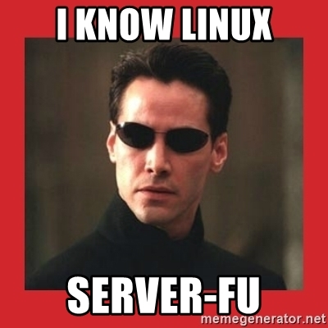

Whew!!! That was a lot ….

Slide 98
Session Survey
•Please complete a short on-line survey about this module at http://bit.ly/xsedesurvey. We value your feedback, and will use your feedback to help improve our training offerings.

